Slide 1

Voice based Email System for the Visually Impaired
Team 12:
Srividya Krishnakumar (55)
CS5A

Slide 2
Contents
Overview
What is IVR?
How does IVR work?
Application of IVR
Design
Implementation
Conclusion
References
Notes:
IVR - Call center -- connecting --- press 1, 2, ...

Slide 3
Overview
Most systems emphasize more on user friendliness of normal users, but not that of all types of people including normal people visually impaired people as well as the illiterate.
The complete system is based on IVR - interactive voice response.
Notes:
IVR - Call center -- connecting --- press 1, 2, ...

Slide 4

The computer prompts the user to perform specific operations.
All operations based on mouse click events.
The action performed by a type of click is specified by the IVR.
Notes:
How will the user know where to click?
As particular location cannot be tracked by the blind user, the system has given the user a free will to click blandly anywhere on the screen.

Slide 5
What is IVR?

Slide 6
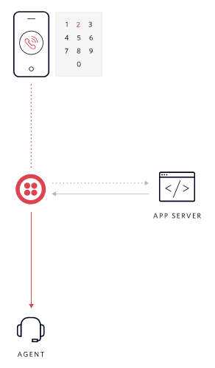
IVR – Interactive Voice Response
Allows callers to navigate a phone system before talking to a human operator
IVR systems are an example of computer-telephone integration (CTI)
The most common way for a phone to communicate with a computer is through the tones generated by each key on the telephone keypad, known as dual-tone multi-frequency (DTMF) signals
Notes:
Computer telephony integration, or CTI, is any technology that allows computers to interact with telephone systems. This allows users to perform all call-related tasks, usually handled through a PBX or key system telephone, directly from their desktop.

Slide 7
How does IVR work?

Slide 8
Each number key on a telephone emits two simultaneous tones: one low-frequency and one high-frequency.
Special hardware - telephony board or telephony card - required to understand the DTMF signals produced by a phone.
The IVR software allows you to pre-record greetings and menu options that a caller can select using his telephone keypad.
Responses: TTS or pre-recorded responses.
Notes:
Pt 1: The number one, for example, produces both a 697-Hz and a 1209-Hz tone that's universally interpreted by the public switched telephone network as a "1.“
More advanced IVR systems include speech-recognition software that allows a caller to communicate with a computer using simple voice commands. Speech recognition software has become sophisticated enough to understand names and long strings of numbers -- perhaps a credit card or flight number.

Slide 9

Applications of IVR
Mobile Purchases
Banking services
Customer Care
Travel Information
Notes:
IVR - Call center -- connecting --- press 1, 2, ...

Slide 10
Design

Slide 11
UI Design
The user interface is designed using Adobe Dreamweaver CS3.
The complete website focuses more on efficiency in understanding the IVR rather than the look and feel of the system.
Notes:
System primarily developed for the visually impaired, so look is not of utmost importance.

Slide 12

Database Design
A database is maintained for user validation and storing user emails.
There are a total of five tables.
The E-R diagram of our complete system is depicted in Fig 1.
The Inbox, Sent-Mail and Trash schemas will store all mails of the respective service that belongs to that particular user.
Notes:
System primarily developed for the visually impaired, so look is not of utmost importance.

Slide 13
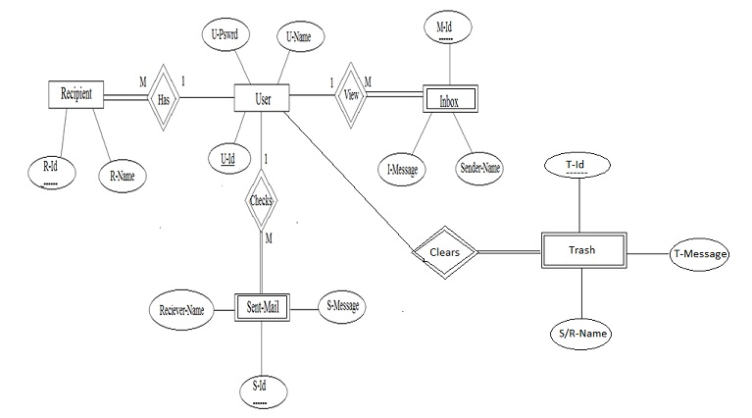

Slide 14
System Design
Fig. 2 depicts the complete system design.
It is the level-2 data flow diagram which gives complete detailed flow of events in the system.
All operations are performed by mouse click events only.
At some places, voice input is required.

Slide 15
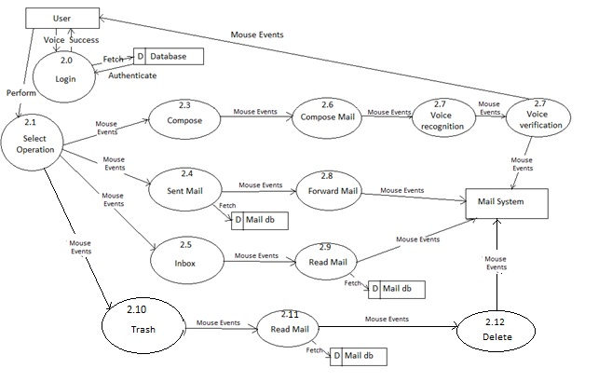

Slide 16
Implementation

Slide 17
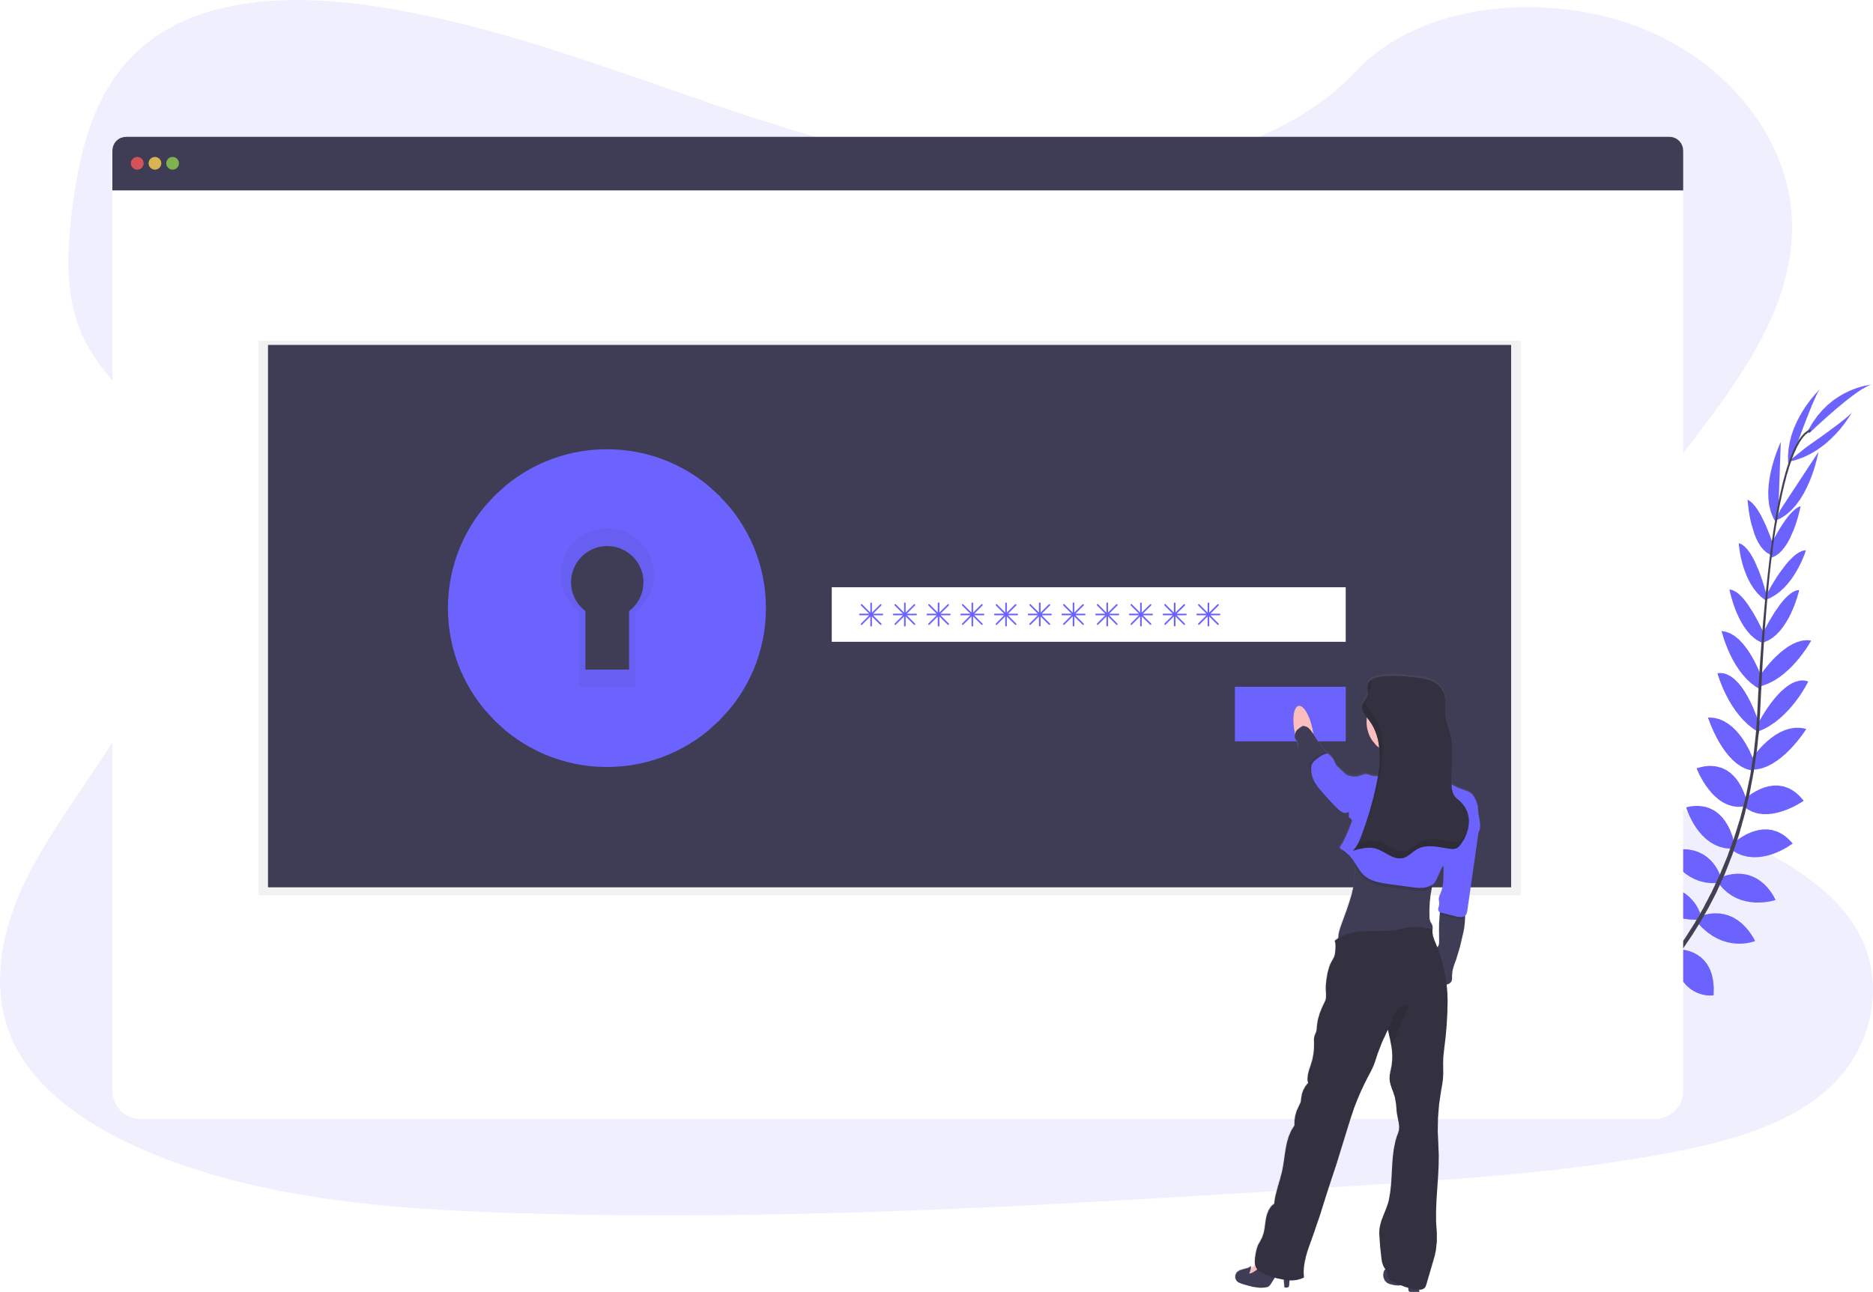
User Registration/Login
New users register with username and password.
Necessary information about the user is prompted during registration.
Username and password accepted as speech input, and validated.
An option to reset password if the user forgets password.

Slide 18
Home Page
User redirected to the home page upon successful login.
Options available for the user:
Inbox
Compose
Sent Mail
Trash
Double click is reserved for logout.
The mouse click operation that needs to be performed is prompted by the IVR.

Slide 19
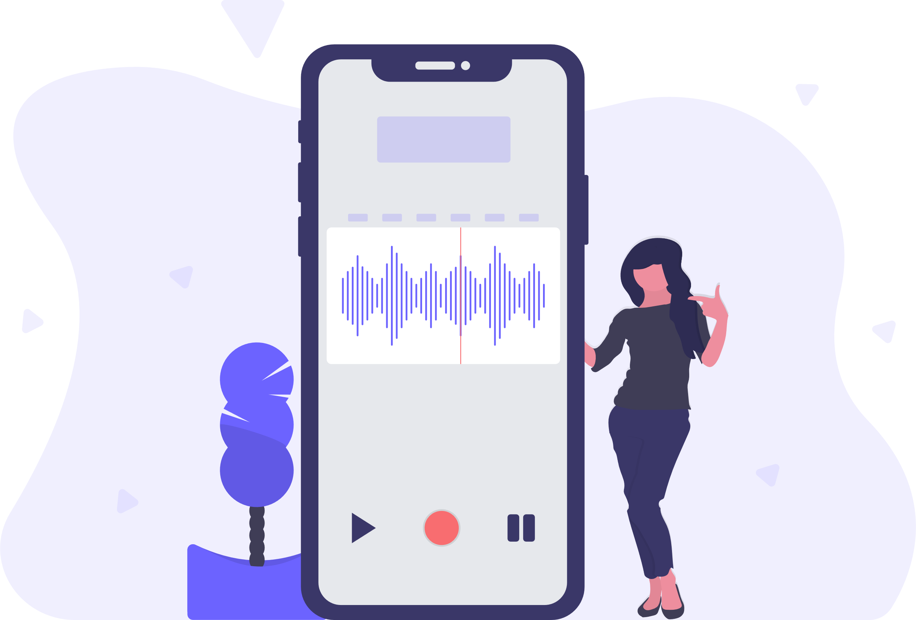
Compose Email
User records a message that needs to be sent.
The voice message goes in the form of an attachment.
Once the message is recorded, the user hears an audio playback to verify the recording.
The message is then sent to the intended recipient.
The receiver downloads the attachment and plays the audio message.

Slide 20
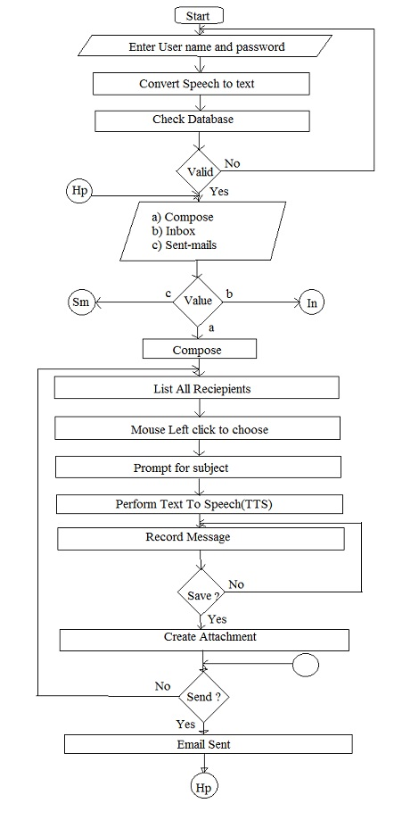
Notes:
In - Inbox
Hp - Home Page
Sm - Sent Mail

Slide 21


Inbox
View all emails received by the user.
Listen to mails by performing the click operation specified by the prompt.
Each time a mail is selected, the user will be informed about its sender and the subject.
User can decide whether the mail needs to be read or not, or whether it should be deleted.
Deleted mails saved in Trash.
Notes:
In order to navigate through different mails prompt will specify which operations to perform.

Slide 22
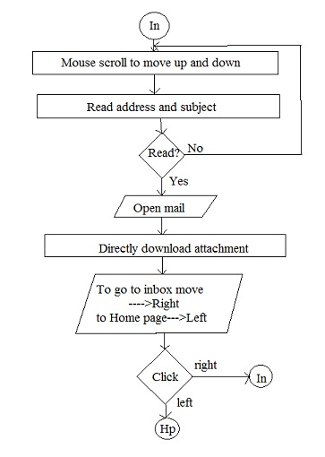
Notes:
In - Inbox
Hp - Home Page
Sm - Sent Mail

Slide 23

Sent Mails
Keeps track of the mails sent by the user.
In order to access the sent mails user will need to perform the actions provided by the prompt.
When the control lands on particular mail, the user is prompted about the receiver and the subject of the mail.

Slide 24

Trash
Keeps track of all the emails deleted by the user.
Mails can be deleted from the inbox or sent mail.
The message can be restored if the user wishes to.

Slide 25
Advantages:
Disadvantages:
User doesn’t have to use the keyboard.
User need not worry about the mouse pointer location.
Accessible to all types of users – visually impaired, literate, illiterate.
Doesn’t fully eliminate the need to use the keyboard.
Not too interactive because it’s based on IVR.
Increased latency.
Insecure credential input.
Emails are sent in the form of audio attachments; not text.

Slide 26
Conclusion
As technology improves each day, it is in our own hands to decide how to use it. .
Voice based systems enable the visually impaired to use tech that they were unable to, while providing the rest with a means of convenience.

Slide 27
References
“Voice-based Email System for the Blind” by T.Shabana, A.Anam, A.Rafiya, K.Aisha
https://en.wikipedia.org/wiki/Interactive_voice_response
https://www.twilio.com/learn/voice-and-video/how-ivr-works
https://electronics.howstuffworks.com/interactive-voice-response1.htm

Slide 28
Thank You!

